Slide 1

6th Grade Accelerated Math
Unit 5, Lesson 8 Applying Ratio Relationships to Percentages Volume 1, pg. 209

Slide 2


Benchmark
MA.6.AR.3.4
Apply ratio relationships to solve mathematical and real-world problems involving percentages using the relationship between two quantities.
volume 1, pg. 209

Slide 3
Integrated Mathematical Thinking and Reasoning Standards
MA.K12.MTR.2.1 Demonstrate understanding by representing problems in multiple ways.
MA.K12.MTR.5.1 Use patterns and structure to help understand and connect mathematical concepts.
volume 1, pg. 209

Slide 4

Learning Targets
I can make connections between ratios and percentages.
I can use double-line diagrams, tape diagrams, and ratio tables to solve problems involving percentages.
volume 1, pg. 209

Slide 5

Warm-Up
volume 1, pg. 209

Slide 6
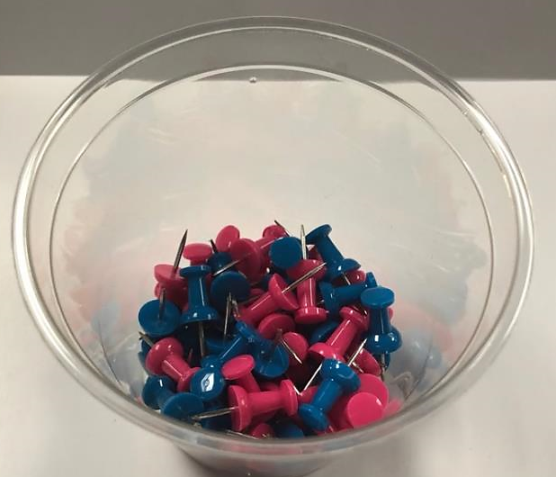
5.8.1 Warm-Up: Estimate the Percentage
A photo of blue and pink thumb tacks is shown.
Based on what is shown in the picture, predict the percentage of thumb tacks that are blue by completing each statement.
volume 1, pg. 209

Slide 7
I know for sure that more than _____% of the thumb tacks are blue.
I know for sure that less than _____% of the thumb tacks are blue.
My best estimate is that _____% of the thumb tacks are blue.
volume 1, pg. 209

Slide 8

Refresher
volume 1, pg. 210

Slide 9
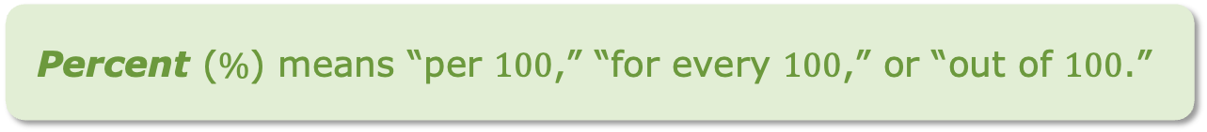
5.8.2 Refresher: Percentages
A percentage is a ratio expressed as a fraction of 100.
Percent ($\%$) means “per $100$,” “for every $100$,” or “out of $100$.”
Work with your partner to complete the following.
volume 1, pg. 210

Slide 10
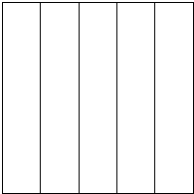
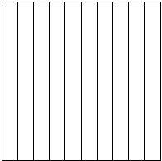
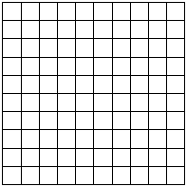
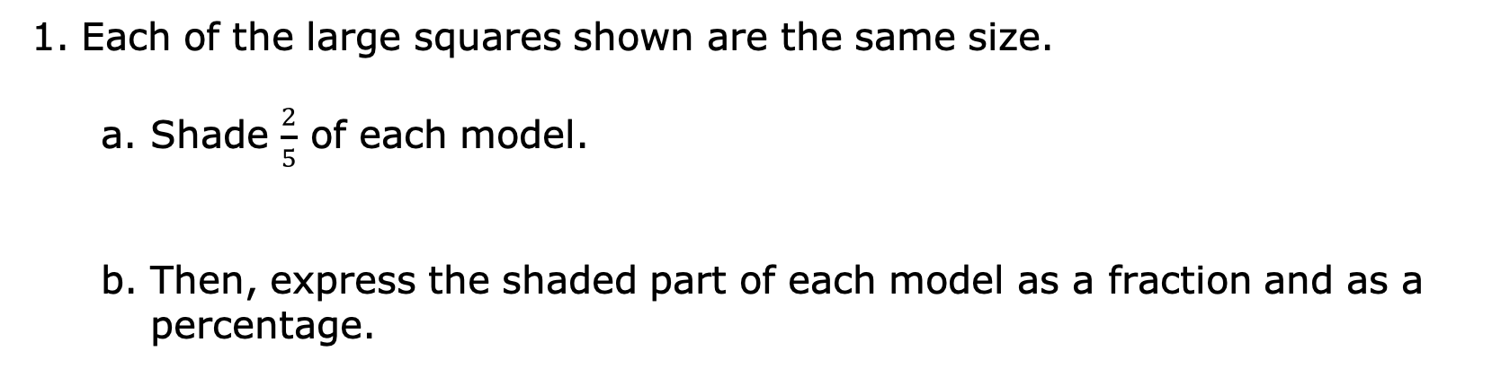
Each of the large squares shown are the same size.
Shade $\frac{2}{5}$ of each model.
Then, express the shaded part of each model as a fraction and as a percentage.
Model
Fraction
Percentage
volume 1, pg. 210

Slide 11
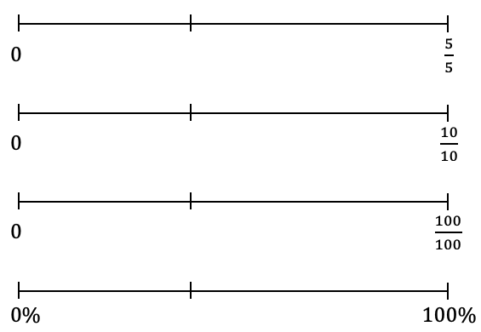
Label the identified tick marks on each number line below to match the models.
volume 1, pg. 210

Slide 12
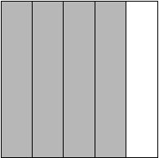
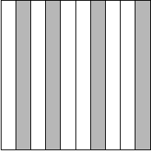
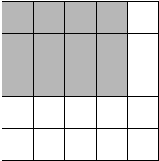
Express the shaded part of each model as a fraction and as a percentage.
Model
Fraction
Percentage
volume 1, pg. 210

Slide 13
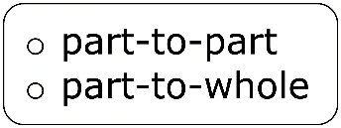
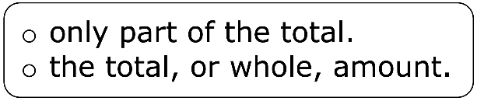
Complete the statements.
Percentages represent relationships where each percentage is a part per 100. In this case, 100% is
volume 1, pg. 210

Slide 14

Guided Instruction
volume 1, pg. 211

Slide 15
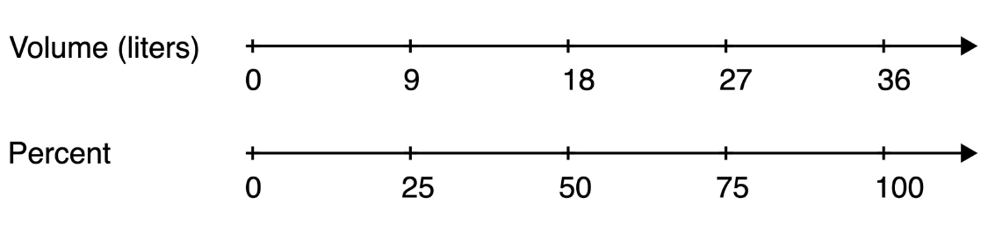
5.8.3 Guided Instruction: Using Ratio Models to Represent Percentages
Double number lines, tape diagrams, and ratio tables can be used to model percentages similarly to other ratios. These can be helpful for determining equivalent ratios and solving problems involving percentages.
Consider a cooking pot that can hold 36 liters of water. The double number line diagram models this situation.
volume 1, pg. 211

Slide 16
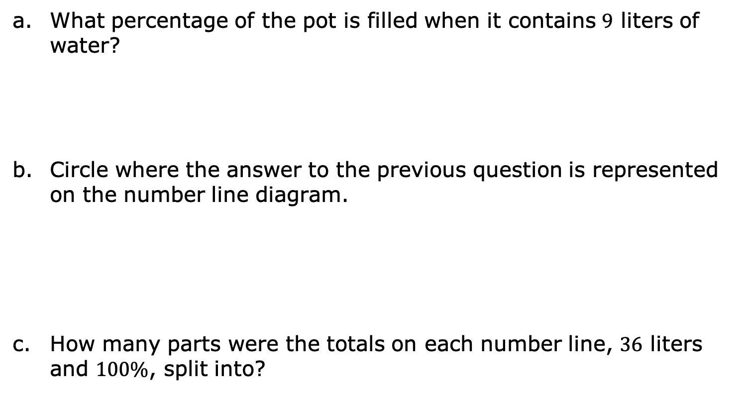
What percentage of the pot is filled when it contains $9$ liters of water?
Circle where the answer to the previous question is represented on the number line diagram.
How many parts were the totals on each number line, $36$ liters and $100\%$, split into?
volume 1, pg. 211

Slide 17
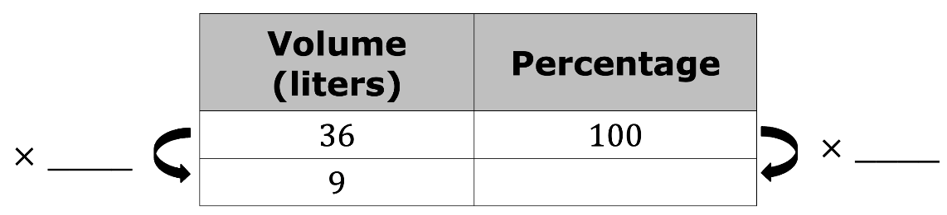
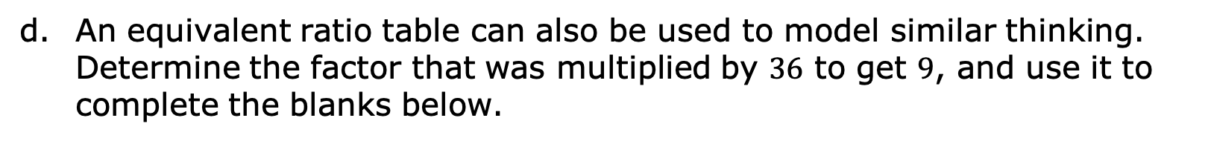
An equivalent ratio table can also be used to model similar thinking. Determine the factor that was multiplied by $36$ to get $9$, and use it to complete the blanks below.
Describe how the factor used to find the equivalent ratio in the table relates to how the number lines were divided in the number line diagram.
volume 1, pg. 211

Slide 18
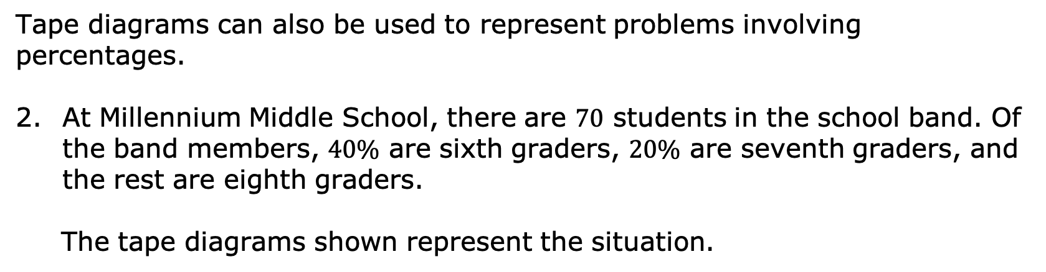
Tape diagrams can also be used to represent problems involving percentages.
At Millennium Middle School, there are $70$ students in the school band. Of the band members, $40\%$ are sixth graders, $20\%$ are seventh graders, and the rest are eighth graders.
The tape diagrams shown represent the situation.
band members
percentage
volume 1, pg. 211

Slide 19
Label each small rectangle in the tape diagram of the band members with the number of students it represents.
Label each small rectangle in the tape diagram of the percentage of band members with the value it represents.
How many band members are sixth graders?
Circle the part of the tape diagram that represents these students.
volume 1, pg. 212

Slide 20
How many band members are seventh graders?
Draw a rectangle around the part of the diagram that represents these students.
What percentage of the band members are eighth graders?
How many band members are eighth graders?
volume 1, pg. 212

Slide 21

Guided Practice
volume 1, pg. 212

Slide 22

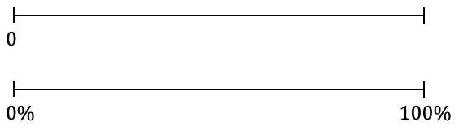
5.8.4 Guided Practice: Using Ratio Models to Represent Percentages
Use the number line diagram to determine what percentage of $80$ is $24$. Then, complete the statement.
$24$ is ____$\%$ of $80$.
Use the tape diagram to determine $70\%$ of $\$60$. Then, complete the statement.
dollars
percentage
$70\%$ of $\$60$ is $\$_______$.
volume 1, pg. 212

Slide 23
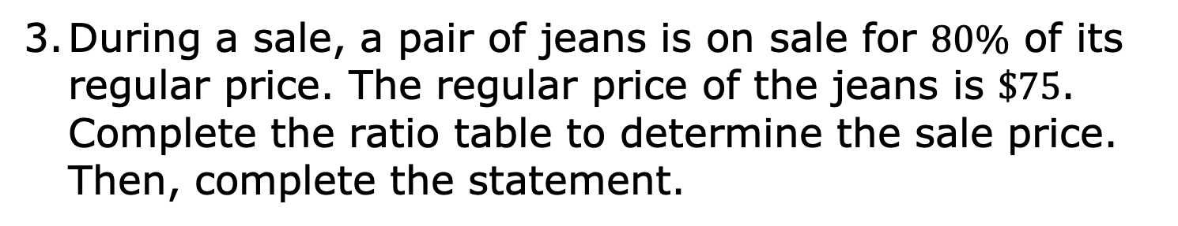
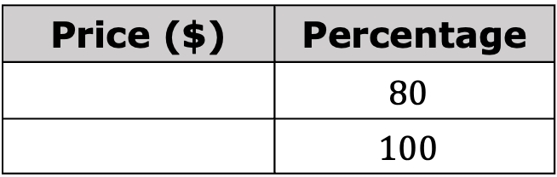
During a sale, a pair of jeans is on sale for $80\%$ of its regular price. The regular price of the jeans is $\$75$. Complete the ratio table to determine the sale price. Then, complete the statement.
Price ($) | Percentage
 | $$80$$
 | $$100$$
$80\%$ of $\$75$ is $\$_______$.
volume 1, pg. 212

Slide 24

Your Turn
volume 1, pg. 213

Slide 25
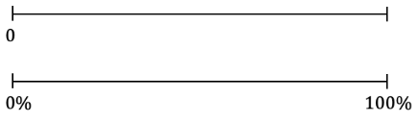
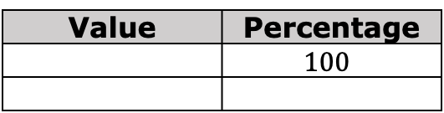
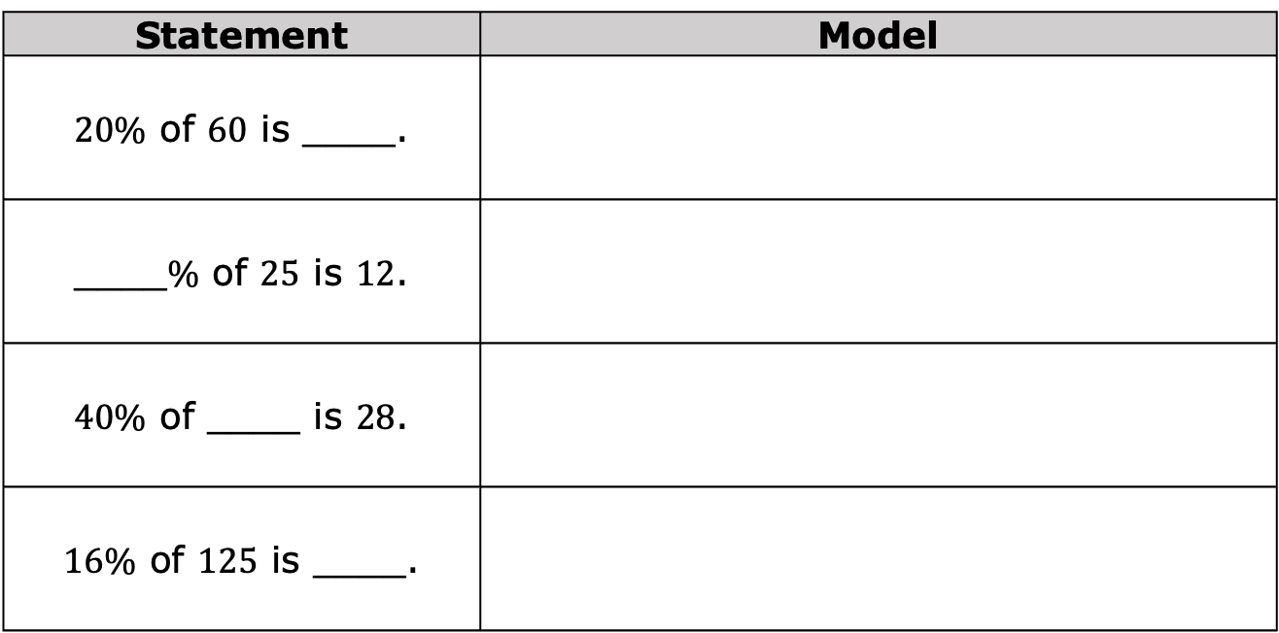
5.8.5 Your Turn!
Use the models to find the values that complete each statement. Show your work.
For the last row, use the model of your choice.
Statement | Model
$20\%$ of $60$ is ____.
____$\%$ of $25$ is $12$.
$40\%$ of ____ is $28$.
$16\%$ of $125$ is ____.
Value | Percentage
 | $$100$$
value
%
volume 1, pg. 213

Slide 26

Wrap-Up
volume 1, pg. 213

Slide 27
5.8.6 Wrap-Up: Reflection
Draw an X on each line to indicate where your current learning is related to each target.
I can make connections between ratios and percentages.
I need help. I can’t get started. | I’m getting there, but I need more practice. | I understand this, and I feel confident.
I can use double-line diagrams, tape diagrams, and ratio tables to solve problems involving percentages.
I need help. I can’t get started. | I’m getting there, but I need more practice. | I understand this, and I feel confident.
volume 1, pg. 213

Slide 28
Write one question you still have about solving problems involving percentages after today’s lesson.
volume 1, pg. 213

